Slide 1






BINARY BEASTS

Slide 2



Every year millions of job seekers, especially freshers, fall victim to fake job listings and HR scams.
These scams promise dream jobs, but demand registration fees document verification charges, or ask users to click malicious links.
With increasing unemployment and desperation for jobs, scammers exploit vulnerable candidates

Slide 3

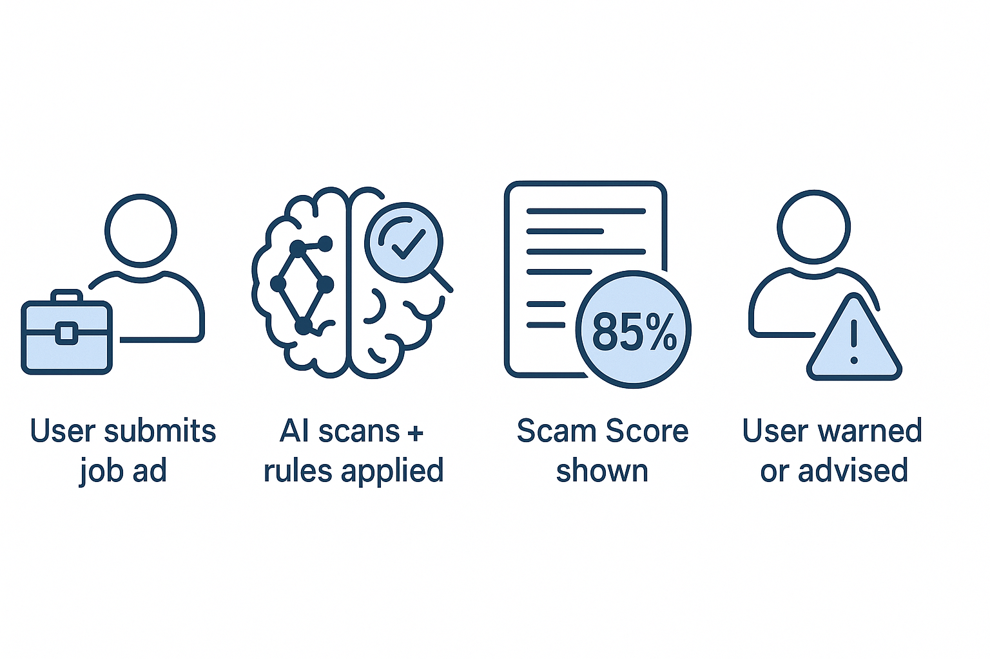

ScamShield is an intelligent platform that helps job seekers identify fake job listings and HR scams automatically using AI, scam pattern detection, and user reports.
Detects Fake Job Listings: Uses rule-based and AI/ML models to scan job descriptions and flag suspicious elements.
Checks Employer Legitimacy: Analyzes email domains, company profiles, and recruiter authenticity.
Scam Score System: Every listing gets a Scam Score (0–100%) based on risk factors.
Real-Time Alerts: Immediate feedback if a listing looks risky or flagged.

Slide 4

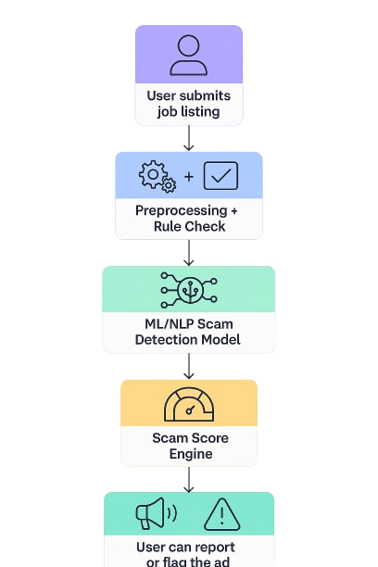

Slide 5


User submits a job listing through the platform.
The listing is first checked using rule-based filters for red flags (e.g., scam keywords, domains).
Then, it is passed through an AI/NLP model trained on real job data to evaluate legitimacy.
A Scam Score (0–100%) is generated with a confidence rating.
The result is shown to the user along with a warning or approval. E.g. A user received a mail for a job offering 2-3LPA and work from home , then the user can easily submit that mail into the ScamShield and our bot would give the scam percentage generating a warning for the user.

Slide 6
KEY FEATURES OF SCAMSHIELD
Job Listing Scanner 🔍
Users can paste or upload job descriptions to instantly check for scam risks
AI/NLP-based Detection 🧠
Scans content using ML/NLP models trained on scam patterns and language.
Scam Score Generator 📊
Gives a scam probability score (e.g., 83%) along with confidence level.
Blacklist Checker ⚠️
Compares HR names, emails, and domains with a crowdsourced blacklist of scams.
.
Novelty
Community-Powered Intelligence 👥
Uses user reports to keep the database growing and make the model smarter over time.
Self-Learning System 📈
The more it's used, the better it detects — thanks to continuous feedback loops.
Focused on Job Scams 🔒
Unlike phishing filters or job portals, ScamShield is 100% focused on fake job listings and HR frauds.
Real-Time Warnings ⚙️
Provides instant scam scores and safety advice — no delay, no confusion.

Slide 7
DRAWBACKS AND SHOWSTOPPERS
Drawbacks (Current Limitations)
Limited Dataset for ML training may lead to false positives/negatives
Accuracy of Scam Score can vary with informal language or unusual formats.
Requires user input (paste job listing) — not automatic yet.
Scam database is still small — needs time and users to grow.
Showstoppers
No verified dataset of scam jobs publicly available for ML — hard to train reliably.
New scam techniques evolve fast — AI model needs constant retraining.
Users may ignore warnings, still fall for scams (human error).
Browser/platform integration challenges — need API access to job portals.

Slide 8
TEAM MEMBERS EMAIL ID’s
BINARY BEASTS
HITESH SANGHI 24cs10hi60@mitsgwl.ac.in
KARTIK SINGHAL 24cs10ka68@mitsgwl.ac.in
EKAGRA GANGIL 24cs10ek47@mitsgwl.ac.in
PARV AGRAWAL 24cs10pa90@mitsgwl.ac.in

Slide 9

Thank you

